Slide 1
BookTech Library Management Team Members: -Omkar Chaudhary -Abdelghani Houbbadi -Soufiane Bannouni -Asjad Anis -Binod Pant

Slide 2
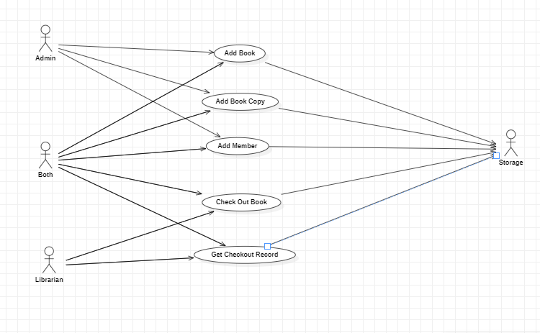
Use Case Diagram

Slide 3
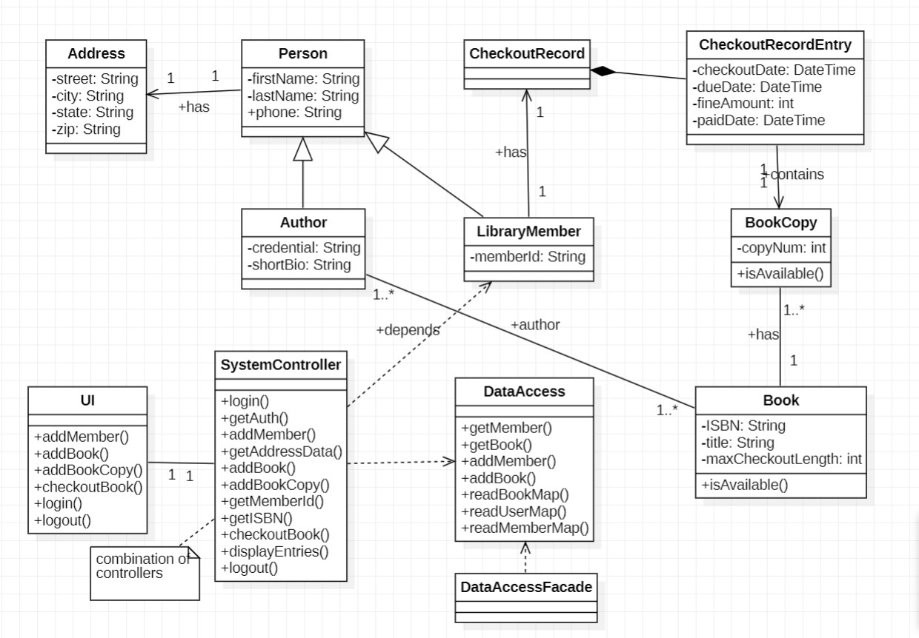

Slide 4
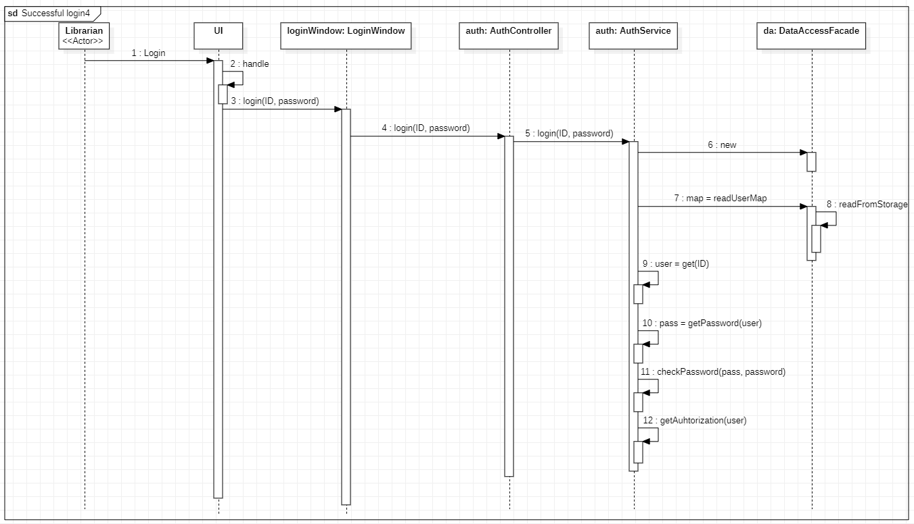

Slide 5
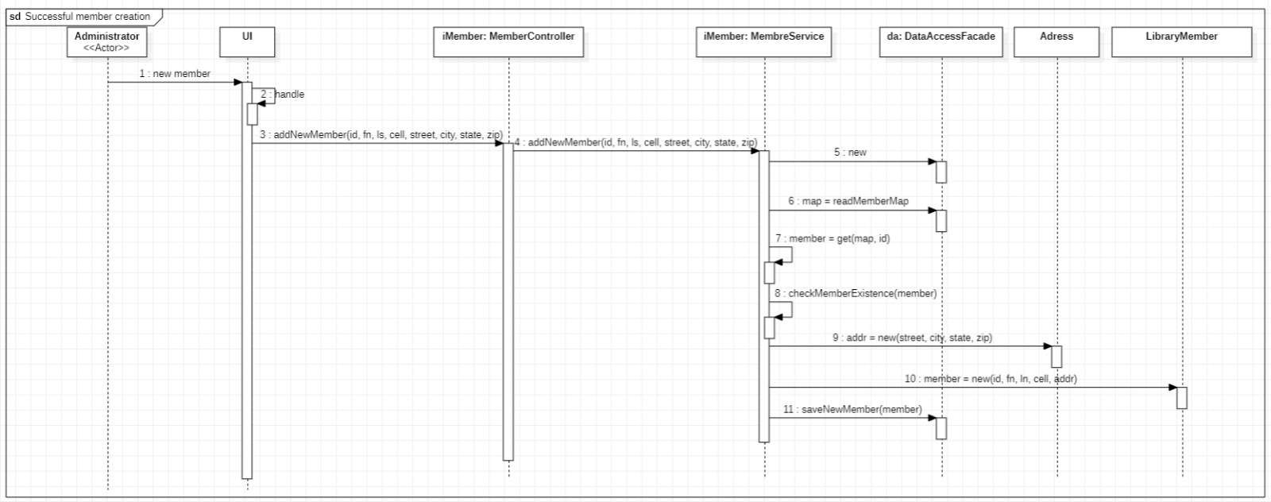

Slide 6
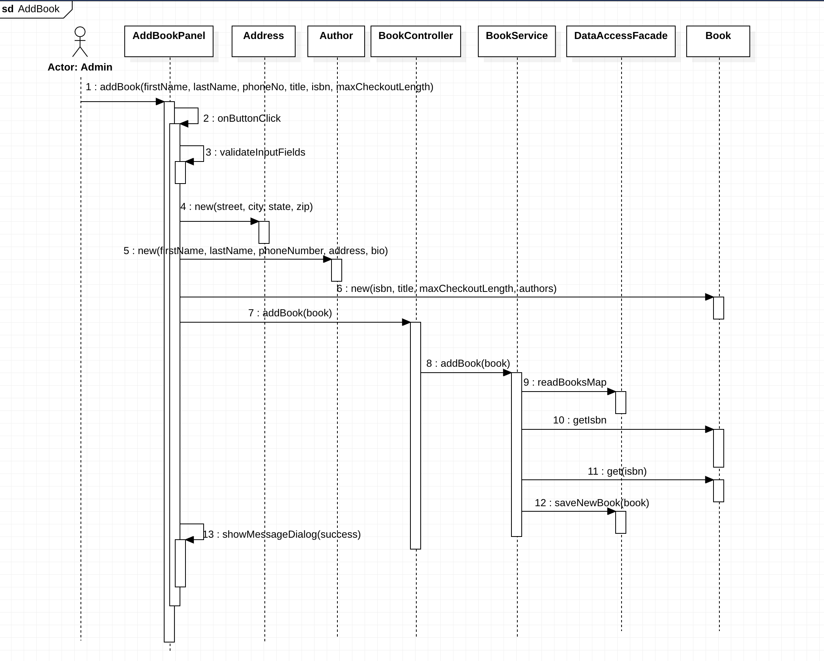

Slide 7
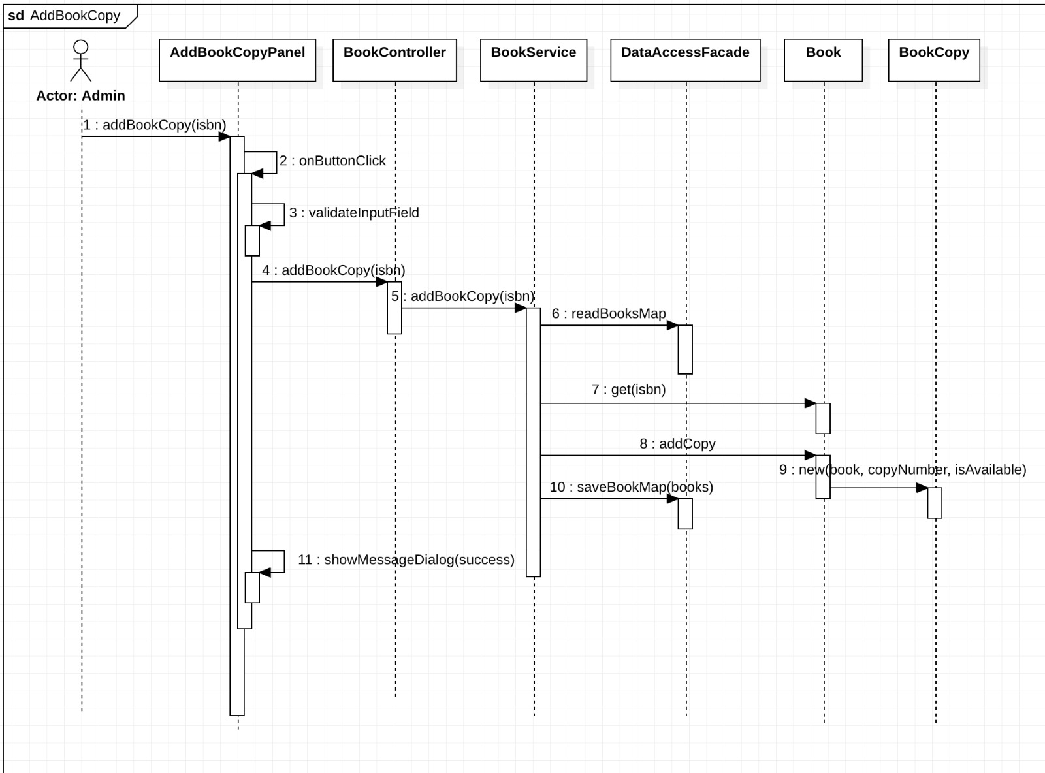

Slide 8
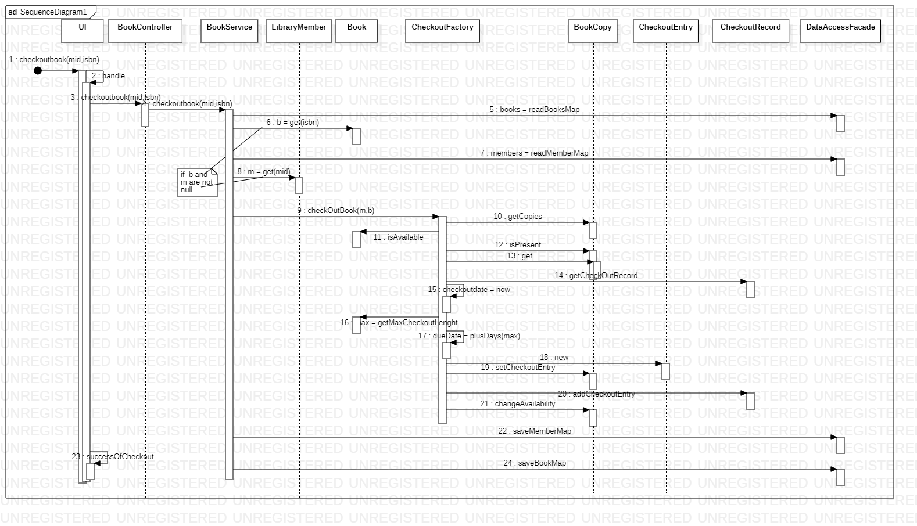

Slide 9
Thank you

